Slide 1

Plaistow Community Kitchen Prototype
Work Experience Project
Designed in Figma

Slide 2
The Problem
Volunteer shifts can be double-booked.
Stock levels may be unclear.
Information is copied manually.
These issues can waste time.

Slide 3
Project Aim
Design a simple interface to help the kitchen organise volunteers, shift bookings, the rota and stock information.

Slide 4
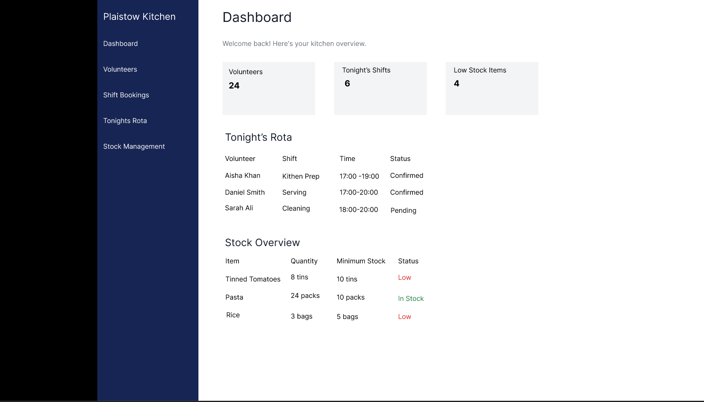
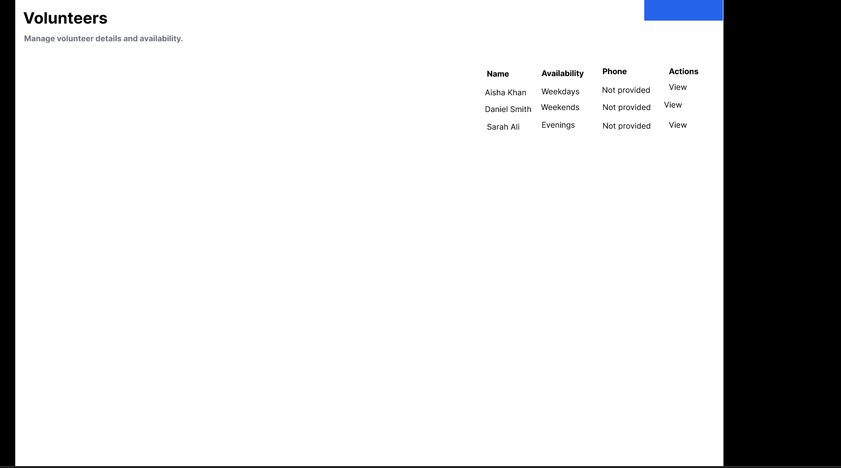
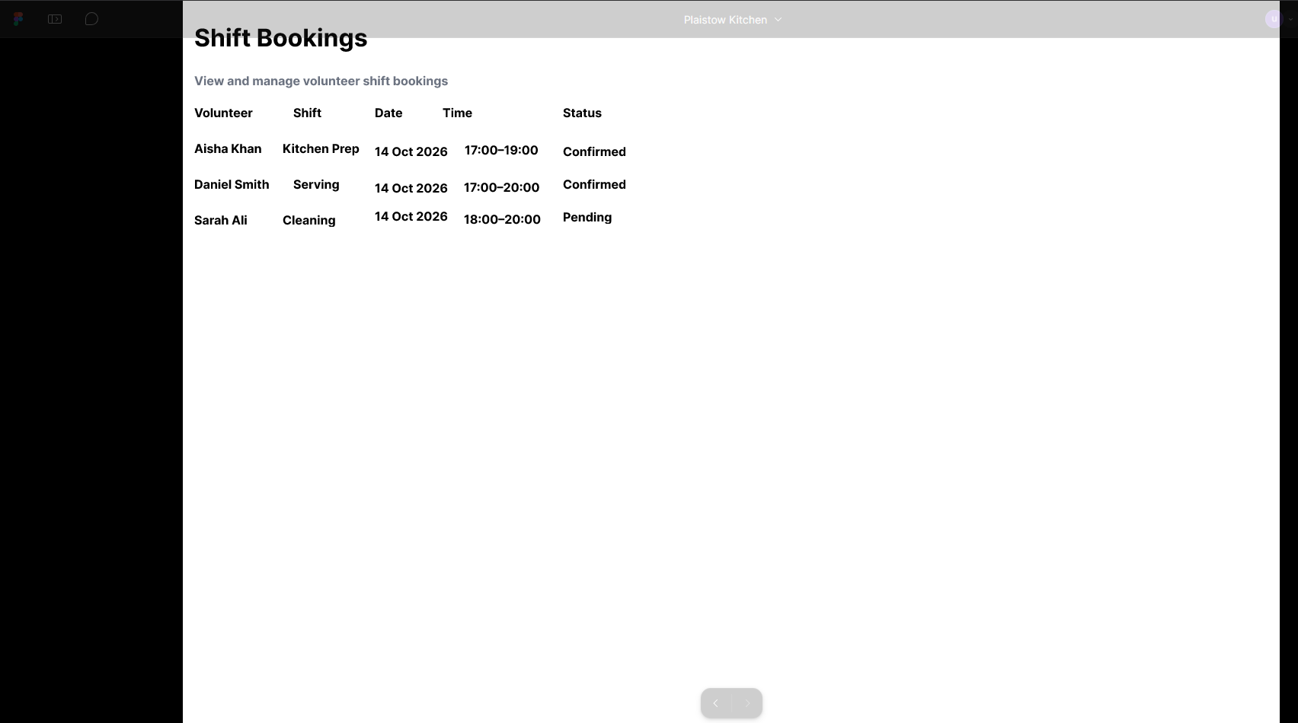
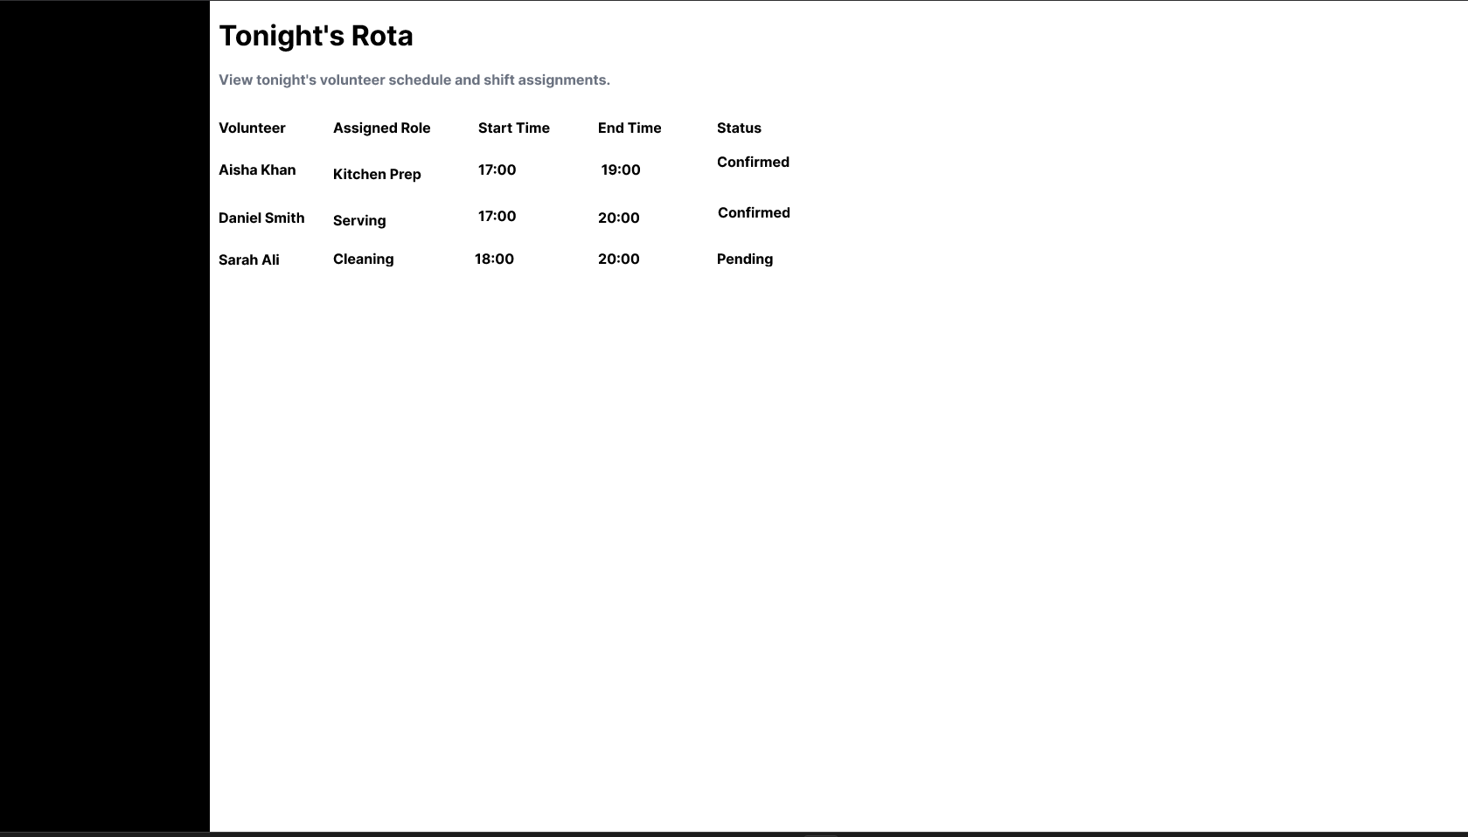
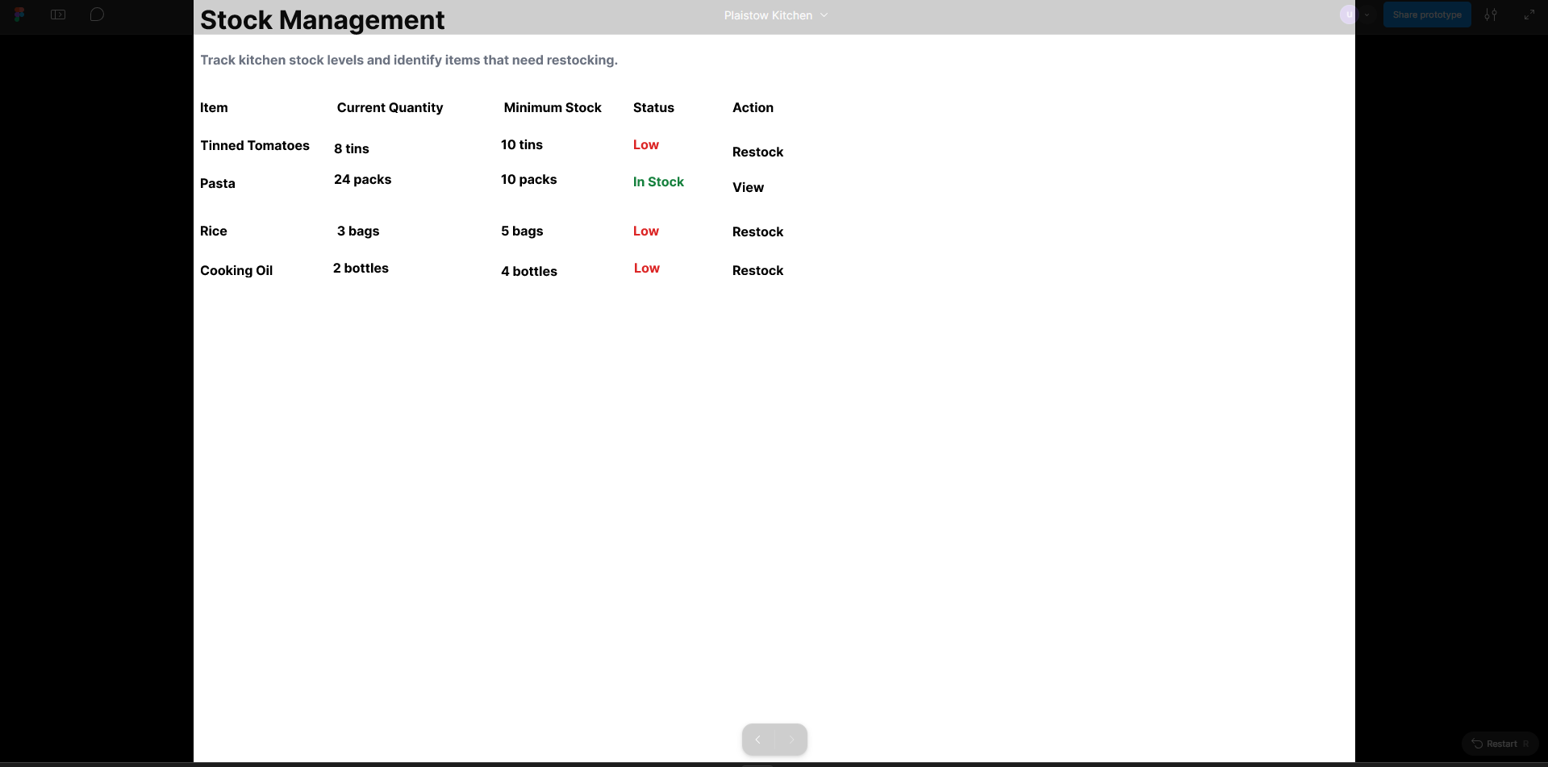
My Prototype
Coordinator Dashboard
Volunteers
Shift Bookings
Tonight's Rota
Stock Management

Slide 5

Data Design
The planned data model contains four main entities: Volunteer, Shift, Booking and Stock Item. These organise the information a working system would need.

Slide 6
Accessibility
Clear navigation labels
Readable text
Consistent layout
Simple interface for users with different levels of technical experience

Slide 7
Testing and Limitations
Testing is planned for navigation, readability and phone-sized screens. The prototype does not yet use a live database or implement automatic booking validation.

Slide 8
Conclusion
The prototype demonstrates a possible way to organise kitchen information. Further testing and development would be needed before it could be used in practice.

Slide 9
What I Would Build Next
With another week, I would develop the prototype into a working system connected to a database. I would add user accounts, validation to prevent double bookings, automatic low-stock warnings and secure access to volunteer information. I would also carry out more usability testing and improve the design using feedback.

Slide 10
What I Learned
This project helped me understand the importance of planning a solution around the needs of its users. I learned how to organise information into different screens, create clickable navigation in Figma and plan a data model. I also learned that a prototype is not the same as a finished system, and that testing and feedback are necessary before a solution is ready for real use.

